Slide 1
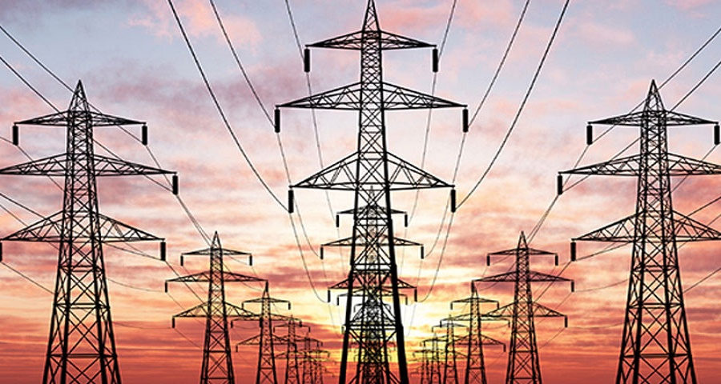
A Green Energy Strategy For India

Slide 2
AGENDA
About Us
Overview
Business Case
India’s Power Sector
Energy Generation
Major Energy Source(Coal)
Energy Consumption
Energy Deficit
Energy Scenario – Health Check
Factors Driving Consumption
Does Energy Really Affect GDP?
Does Population Affect Energy?
Heading Towards Fully Electric India-Electrification Rate
Consumption Per Capita
Forecasted India (2014 - 2040)
Renewable Energy Sources
Why Renewable Energy for India?
India - Renewable Energy (2014 - 2017)
Potential Sites with Renewable Resources
Cost Analysis of Energy Resources
From Inaction to Action
Energy and National Security
Acknowledgment

Slide 3
OVERVIEW
“Energy is like blood in the veins. It is as vital as that to the economic growth”.
India is at the forefront of global energy scenario today, being one of the leading power consuming and generating nations.
India is 3rd largest Consumer of energy after USA and China with 6% of world's energy consumption but per capita consumption is lowest indicating huge demand surge is imminent.
Economic growth, rising population, low per capita energy consumption and rapid urbanization are likely to spurt the energy demand further.
Renewable energy will also play a huge part in India’s economic growth, if India wants to meet its growing demand.
To cope up with people’s dissatisfaction in the election time, PM Modi had promised to electrify the villages and rural regions . They have hired us to look at the energy gaps and ascertain whether renewables can be a sustainable resource and if it could fill the energy deficit.
States are given more preference with GDP higher than average relationship between energy consumption and GDP .

Slide 4
BUSINESS CASE
The main OBJECTIVES of this presentation:
To apprise key stakeholders of the present electricity scenario.
Reduce dependency on imports of energy sources like coal and oil.
The usage of Coal & Oil triggers higher imports.
Imports are vulnerable to global supply disruptions and price volatility due to global events.
To enlighten on electricity deficiency problem and leading role of the alternative energy sources , namely renewables for future survival.
Propose options on sustainable development in the field of power sector which is critical for Indian Economy.
To highlight the urgent need of reforms in power sector, not just in power generation but also transmission, distribution and the pricing of electricity.

Slide 5
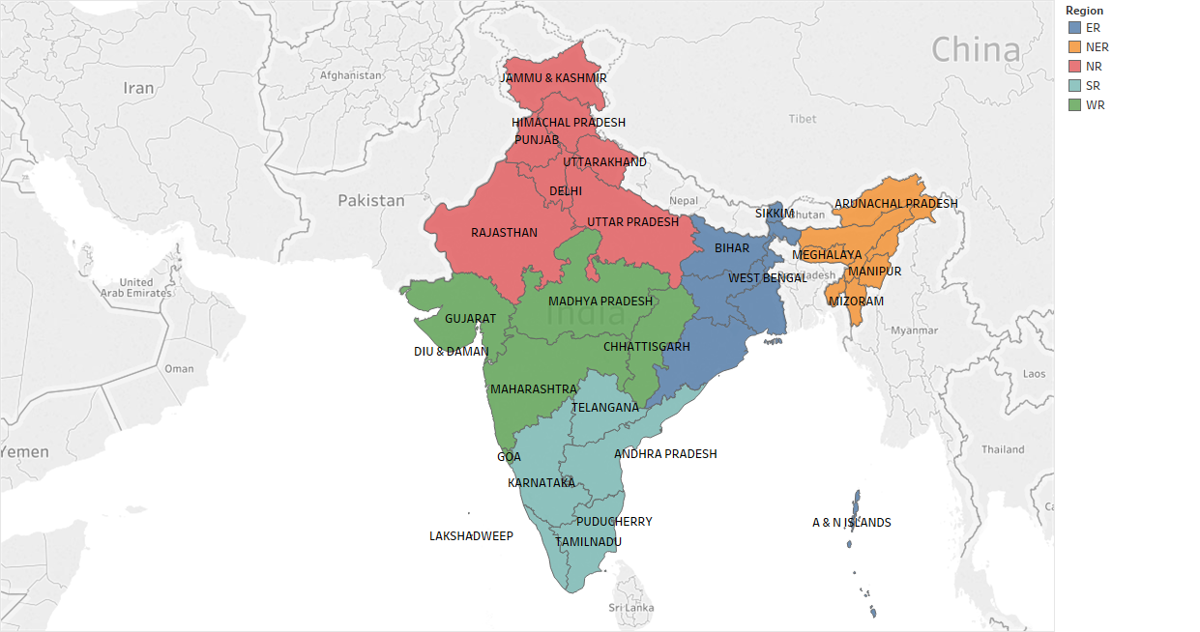
INDIA’S POWER SECTOR- Region Wise A QUICK GLANCE

Slide 6
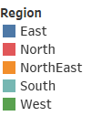
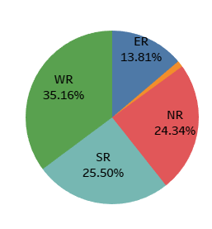
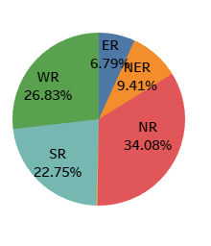
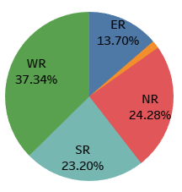
ENERGY GENERATION (2016)
Installed Capacity Potential Capacity Energy Across Regions
Installed Capacity:
Total : 298509 MW
Highest :Western Region : 35%
Lowest : North-Eastern : 2%
Potential Capacity:
Total : 1266998 MW
Highest :Northern Region : 34%
Lowest :Eastern Region : 6%.
Electricity distribution
Total : 267,403.42 MW
Highest : Western Region :37%
Lowest : North-East : 1.5%

Slide 7
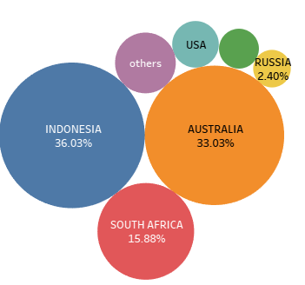
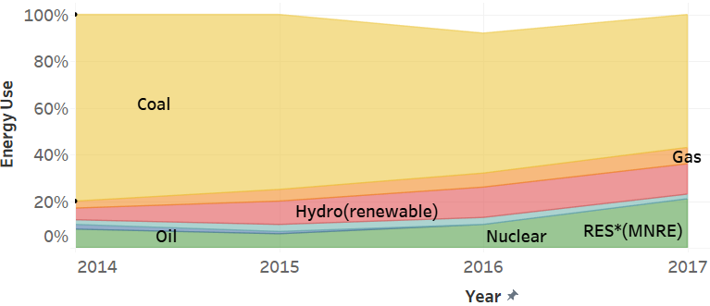
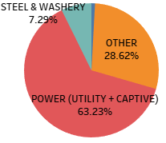
MAJOR ENERGY SOURCE (COAL)
Energy Sources Consumption (Coal) Imports of Coal
Presently maximum amount of electricity is generated from coal.
India is heavily importing coal making it dependent on many countries.
maximum amount of coal is used in power sector.

Slide 8
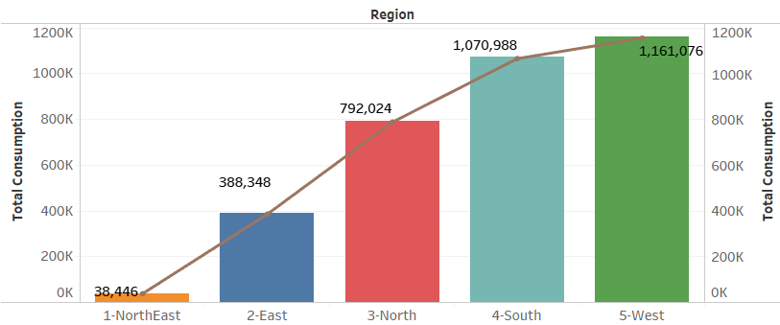
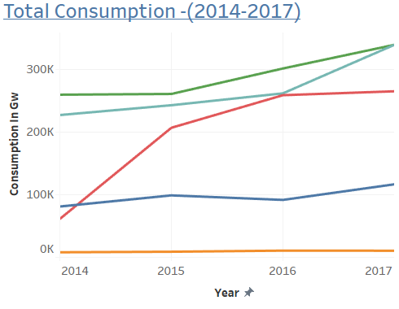
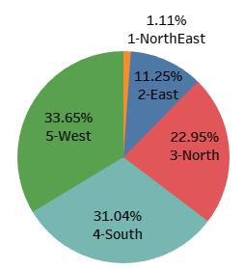
ENERGY CONSUMPTION TREND (2014-2017)
Energy Consumption (Region): Energy Consumption (Period) :
Total : 946,600 GW The Energy Consumption is increasing
Highest :Western Region : 34% over period (2014-2017)
Lowest : North-Eastern : 1.2% Reasons:
Industrialization
Population
Urbanization

Slide 9
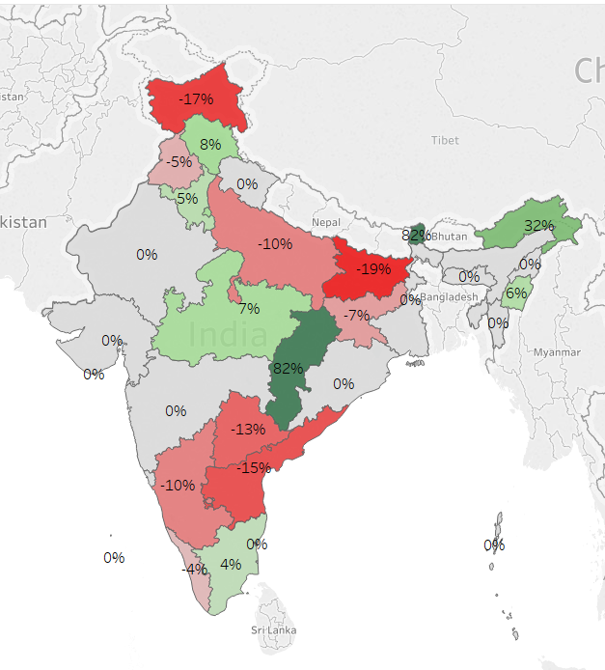
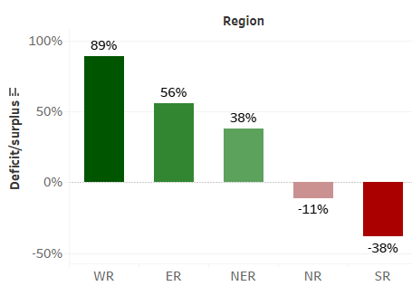
ENERGY DEFICIT (2016)
State Wise Region Wise
States with Surplus
Chhattisgarh
Madhya Pradesh
Tamil Nadu
Himachal Pradesh
Sikkim.
States with deficiency
Andhra Pradesh
Andhra Pradesh
Karnataka
Bihar
Jammu & Kashmir
Jharkhand
Regions with Surplus
Western Region
North Eastern
Eastern region
Regions with deficiency
Southern Region
Northern Regions
All other remaining states are self sufficient

Slide 10
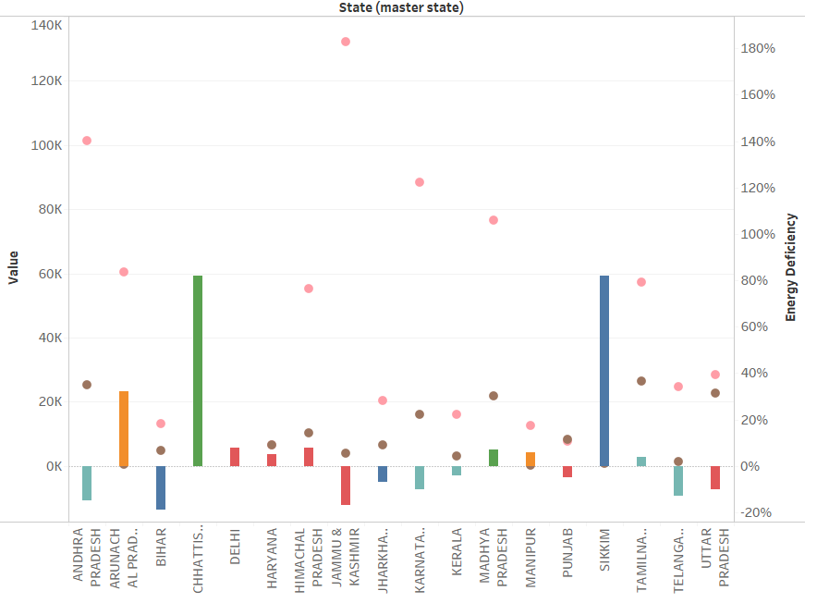

States with deficit
Andhra Pradesh
Bihar
Jammu & Kashmir
Karnataka
Kerala
Telangana
Uttar Pradesh
Reason:
Not exploiting their potential to generate energy to the fullest
States fully exploiting potential Capacity:
Delhi
Chhattisgarh
Sikkim
Punjab
Andhra Pradesh ,Himachal, Jammu & Kashmir, Karnataka , Madhya Pradesh have too much potential to make them energy surplus states

Slide 11
ENERGY SCENARIO – HEALTH CHECK
India ranks 81 position in overall energy self-sufficiency at 66% in 2017
India's electricity sector is dominated by fossil fuels, and in particular coal, which in 2016 produced about three fourths of all electricity.
Due to dependency on non renewable energy it is making India dependent on other countries for imports and increasing environmental hazards.
According to world’s bank report :
Population:
In India nearly 85% of the country’s population having access to electricity
Challenges still remain to provide electricity to the rest of the 15% of the 1.25 billion population
GDP :
A sustained 8% GDP growth of India requires an annual increase of:
Commercial energy supply from 3.7% to 6.1%
Total primary energy supply from 2.2% to 5.1%
Target is to fully electrify India by 2025 as promised by government

Slide 12
Factors driving consumption
Demand has the following key drivers:
Industrialization
Population
Urbanization
Agriculture
Average Household consumption
Electrification of rural areas
Weather
These factors can be measured with:
Increase in GDP : Economic growth measured by per capita GDP is an important factor in energy consumption. Mainly economic growth shows the effect on energy demand.
Population Growth : with continuous improvement in the public revenue and living standards, energy consumption will increase with the steady growth of population
Electronification Rate: Indicates the % of population or households with electricity. Higher the rate symbolizes the higher economic growth.
Consumption Per Capita: Indicates the average consumption by a person belong to a particular nation calculated from the known total consumption of that nation and the total population. Higher the consumption per capita shows surplus of energy

Slide 13
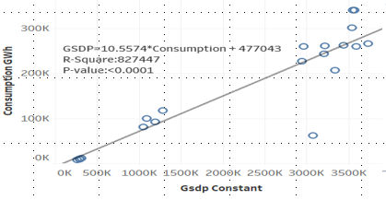
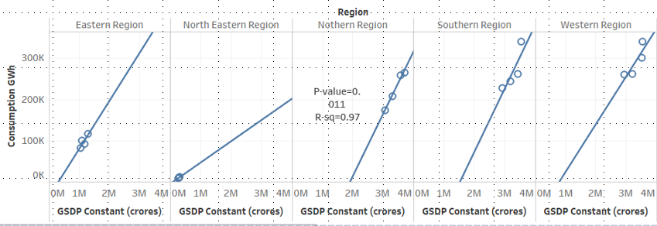
DOES ENERGY REALLY AFFECTS GDP?
“Energy is the power to make us do things”
GSDP V/s Consumption GSDP V/s Consumption (Region)
Both Consumption and GDP shows an increasing trend from 2014 to 2017.
The GDP growth rate from 2014 to 2017 is stable and is around 10% per year and the Growth rate of Consumption is not linear.
Over a period of 2014-2017 , the growth of in Northern region is evidently following linear relation ship between the GDP and the energy consumption than compared to other regions.
The Western region and the North Eastern region has more positive correlation between Energy consumption and GDP
Economic well-being is directly coupled with increase in energy use and population growth, as it generates more goods and services.

Slide 14
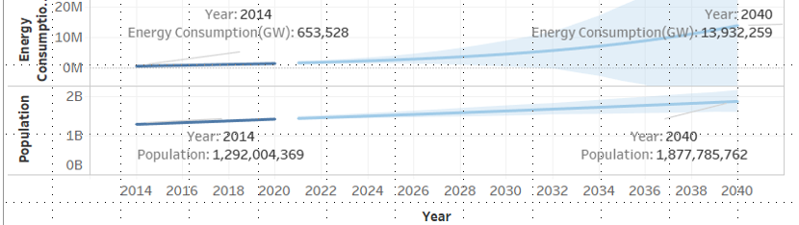
Does Population AFFECTS Energy?
Forecast-Energy & Population(2014-2040)
Forecast Period: 2022-2040
For every 1% increase in population, the energy consumption is estimated to increase with 12% (keeping external factors constant) . https://drive.google.com/file/d/1Ky5a63IxYCLnuybK6cSrPeh3QDdY23hm/view?usp=sharing
REGION WISE
East Region : 8% increase in consumption rate for unit increase in Population.
North East Region : 11% increase in consumption rate for unit increase in Population.
North Region : 7% increase in consumption rate for unit increase in Population.
South Region :6% increase in consumption rate for unit increase in Population.
West Region : 8% increase in consumption rate for unit increase in Population.

Slide 15
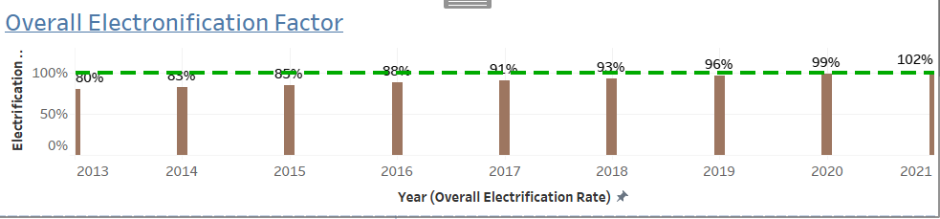
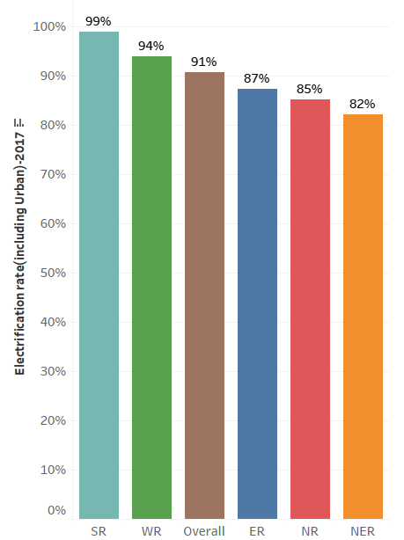
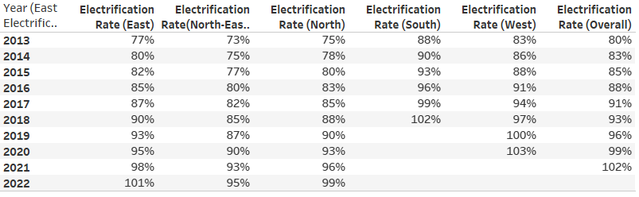
HEADING TOWARDS FULLY ELECTRIC INDIA
Overall Region-wise
Electrification Rate
https://drive.google.com/open?id=1Ky5a63IxYCLnuybK6cSrPeh3QDdY23hm explains the methodology followed for computation.

Slide 16
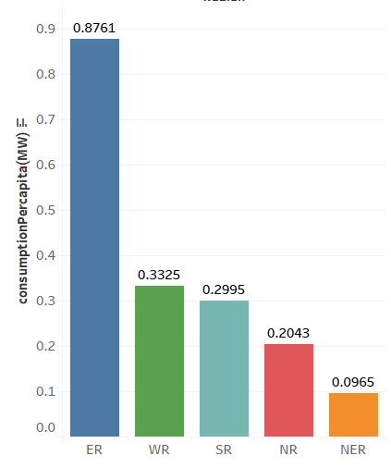
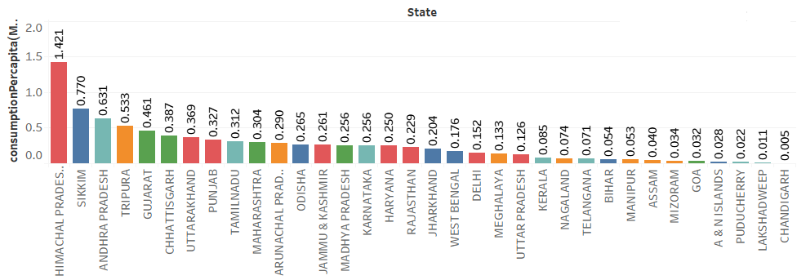
CONSUMPTION PER CAPITA
State-Wise Region-Wise
CONSUMPTION PER CAPITA
*BASED ON THE ELECTRONOFICATION FACTOR CONSUMPTION PER CAPITA IS CALCULATED
Consumption Per Capita = Consumption/(population * Electronification factor)
By using Electronification factor , we can include the people who are actually having access to the electricity
State Wise
Highest : Himachal Pradesh :1.42Mw
Lowest : Chandigarh : 0.005Mw
Region Wise
Highest : Eastern Region :0.867Mw
Lowest : North east : 0.0965Mw

Slide 17
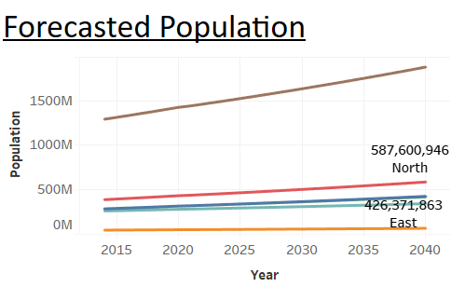
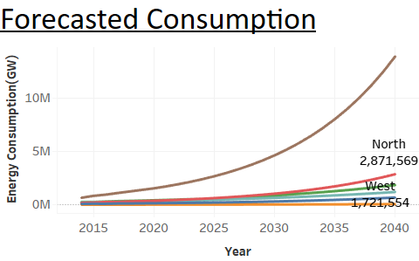
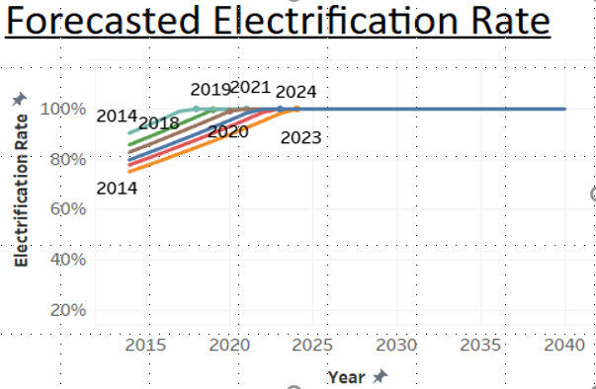
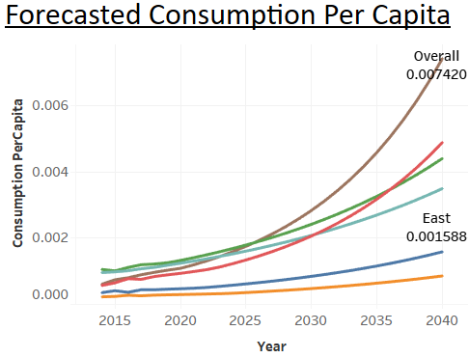
Forecasted India (2014-2040)

Slide 18

PROPOSED SOLUTIONS

Slide 19
RENEWABLE ENERGY Sources
Wind
Hydro
Biomass & Waste
Solar
Geothermal
Tidal

Slide 20
WHY RENEWABLE ENERGY FOR INDIA?
India has a large potential for energy generation by utilization of renewable energy sources due to its geographical location
Rising Prices for Oil & Gases
Ecological Hazards - Unlike conventional thermal power generation from coal, they do not cause pollution and generate clean power
Ample Resources and Sites availability
Abundant sunshine
Avoids the high cost involved in transmission
Avoids recurring fuel cost
Boosts the urban and rural economy

Slide 21

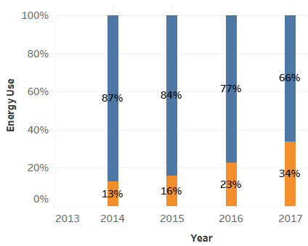
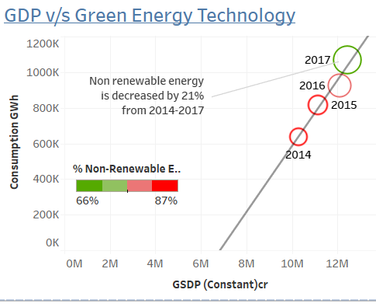
INDIA - RENEWABLE ENERGY (2014-2017)
Non-Renewable to Renewable Energy Progression Map
Decrease in non-renewable energy consumption by 21%
We can see the impact of moving towards renewable energy resources on GDP i.e. with increasing use of renewable energy GDP is also showing progression.

Slide 22
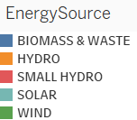
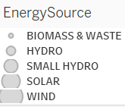
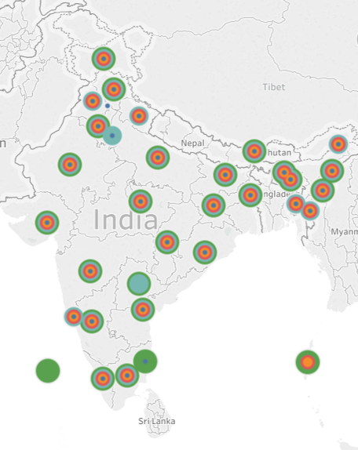
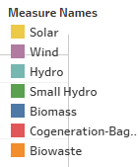
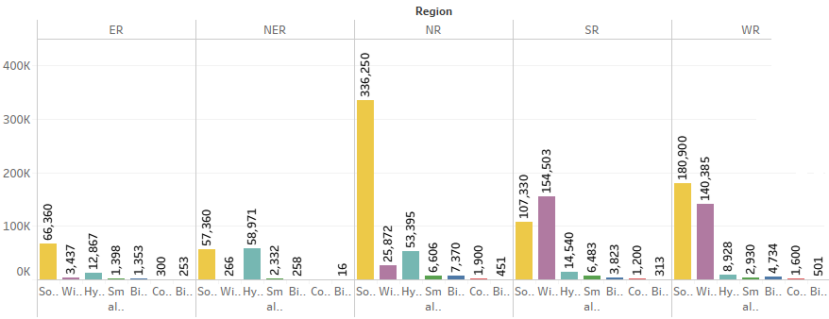
Potential sites with renewable resources
Hydro
Highest :Arunachal Pradesh
Small hydro
Highest :Karnataka
Solar
Highest :Rajasthan
Wind
Highest :Gujarat
Biomass
Highest: Punjab
Renewable sources-Region wise
Highly used Renewable source:
Solar
Wind
Hydro
Highest generating region :
Northern region is having majority of generation from renewable sources.

Slide 23
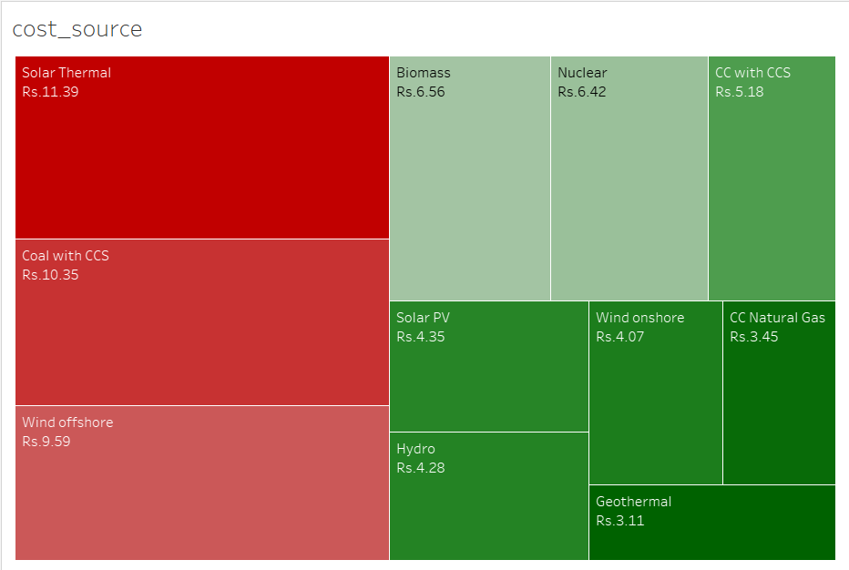

COST ANALYSIS OF ENERGY RESOUCES
Cost taken is in terms of levelized cost. It represents actual cost to society without government incentives.
However, the price of coal-based electricity can nearly double due to government imposed cost on CO2 emissions.
Photovoltaic systems are still more expensive than fossil-based ones, although PV cost keeps falling every year.
*NOTE:-Cost analysis is according to USA as all the renewable projects are not being implemented in India
Reference http://www.renewable-energysources.com/

Slide 24
FROM INACTION TO ACTION
Minimise the import of Oil & Gases
Need to reduce energy-related CO₂ emissions to limit climate change (Decarbonisation )
Nullify the energy deficit by iimproving the production from renewable energy sources
Minimise the effect of global market crisis and price volatility
Decrease cost of production and maximise the growth
Lower transmission and distribution costs
Minimise the Reserves
Promoting of energy efficiency methods by using renewable sources.
The identification and analysis of key metrics across large industries and suggest the best way to check with renewable energy-related policies.

Slide 25
ENERGY AND NATIONAL SECURITY
Energy security is the association between national security and the availability of natural resources for energy consumption.
Threats to energy security include the political instability, the manipulation of energy supplies, attacks on supply infrastructure, natural disasters, terrorism, and reliance on foreign countries for oil.
New threats to energy security have emerged in the form of the increased world competition for energy resources due to the increased pace of industrialization in countries such as India
The modern world relies on a vast energy supply to fuel everything from transportation to communication, to security and health delivery systems.
It is time to define "a global energy policy model, which not only aims at ensuring an efficient environmental protection but also at ensuring security of energy supply"

